Slide 1
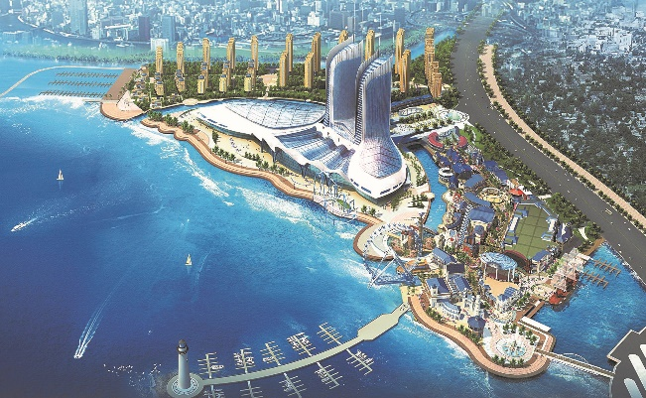


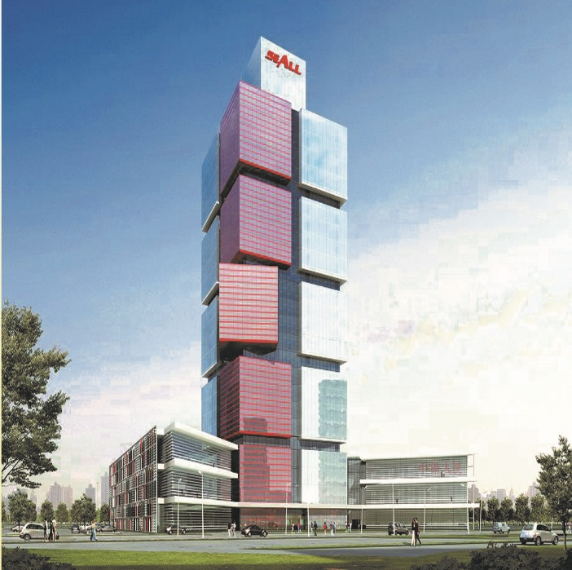
NANTONG ERJIAN
CONTRACTING CO. L.L.C
COMPANY PROFILE
UNITED ARAB EMIRATES
CHINA
LEBANON

Slide 2
NANTONG ERJIAN CONTRACTING CO. L. L.C
CONTENTS
General Information
Scope of Services
Organization Chart
Staff List
Major Projects
Equipment List
Quality Management System
Financial status & statements
Trade Licenses & Classifications
Photo Gallery of Selected Projects

Slide 3
NANTONG ERJIAN CONTRACTING CO. L. L.C
GENERAL INFORMATION

Slide 4
                NANTONG ERJIAN CONTRACTING CO. L.L.C
Mission
Vision
Values
NANTONG ERJIAN CONTRACTING CO. L. L.C was established in the United Arab Emirates in 2010 under the name of “Directions”, and later changed to “Fucheng Middle East Contracting” as Chinese partners with different expertise joined for the purpose of serving the construction industry in UAE Region. The Chinese partners brought their expertise to the company such as Fujian Hydro electric in water and dams, Shenzhen piling in soil mechanics, Nantong No. 2 group in building & infrastructure.
Recently Jiangsu Nantong No.2 Construction Engineering Group Co., LTD (hereafter called Nantong (China)), ranking top 500 enterprises of China, acquired the major shares in the company to become Nantong Erjian Contracting Co. L.L.C with Nantong(China) as leader of the company.
M/s NANTONG(China), ranking top 500 enterprises of China, a special grade in housing construction, first grade in municipal public works and first grade in infrastructure works entity, with annual turn over in excess of 80 billions dollars (see the attached project list)
Eng. Charles Chami, partner, founder of Directions UAE, Pilex UAE, Eagle engineering Lebanon, is also a grade “A” construction entity established since 1978 still managing the company along with the Chinese partners.
.

Slide 5
                NANTONG ERJIAN CONTRACTING CO. L.L.C
Mission
Vision
Values
We are determined to make available their respective Company’s resources and projects experience to insure a successful start up of operations with a clear vision of turning NANTONG ERJIAN CONTRACTING CO. L. L.C into one of the leading Construction businesses in the UAE.
NANTONG ERJIAN CONTRACTING CO. L. L.C is totally devoted to excellence & ingenuity in the field of construction, consolidating the efforts, resources and experiences of both China, Lebanon and UAE.
NANTONG ERJIAN CONTRACTING CO. L. L.C aims at achieving its goals adopting value engineering, environmental, health and safety procedures with utmost focus on market and clients` needs, values and standards, with integrity, transparency and quality.
.

Slide 6
NANTONG ERJIAN CONTRACTING CO. L. L.C
SCOPE OF SERVICES

Slide 7
                NANTONG ERJIAN CONTRACTING CO. L.L.C
NANTONG ERJIAN CONTRACTING CO. L.L.C has been active in serving both Public and Private sectors Its services and expertise cover the following main fields
ALL TYPES OF BUILDING WORKS INCLUDING BUT NOT LIMITED TO: offices, residential, industrial, schools, hospitals, public buildings & high rises.
ALL TYPES OF TRANSPORT STRUCTURES INCLUDING BUT NOT LIMITED TO: bridges, tunnels, viaducts, roads & runways and their related infrastructure works and Utilities
ALL TYPES OF HEAVY CIVIL WORK INCLUDING BUT NOT LIMITED TO: hydroelectric power plants, thermo plants, switch yards & sub stations , marine works, airports, sewage & water plants and tanks, dams &artificial lakes
STRENGTHENING ,REPAIR & REHABILITATION WORKS INCLUDING BUT NOT LIMITED TO: Buildings, concrete & steel structures & ancillaries
ELECTROMECHNICAL WORKS
ALL TYPES OF STEEL STRUCTURES INCLUDING BUT NOT LIMITED TO: steel works, aluminum works and related structures
INTERIOR DECORATION WITH SPECIAL JOINERY & CARPENTRY WORKS
VALUE ENGINNERING, CONSTRUCTABILITY & CONSTRUCTION MANAGEMENT METHADOLOGIES & REVIEWS
IRRIGATION, HARDSCAPE, LANDSCAPE WORKS
.

Slide 8
NANTONG ERJIAN CONTRACTING CO. L. L.C
ORGANIZATION CHART

Slide 9
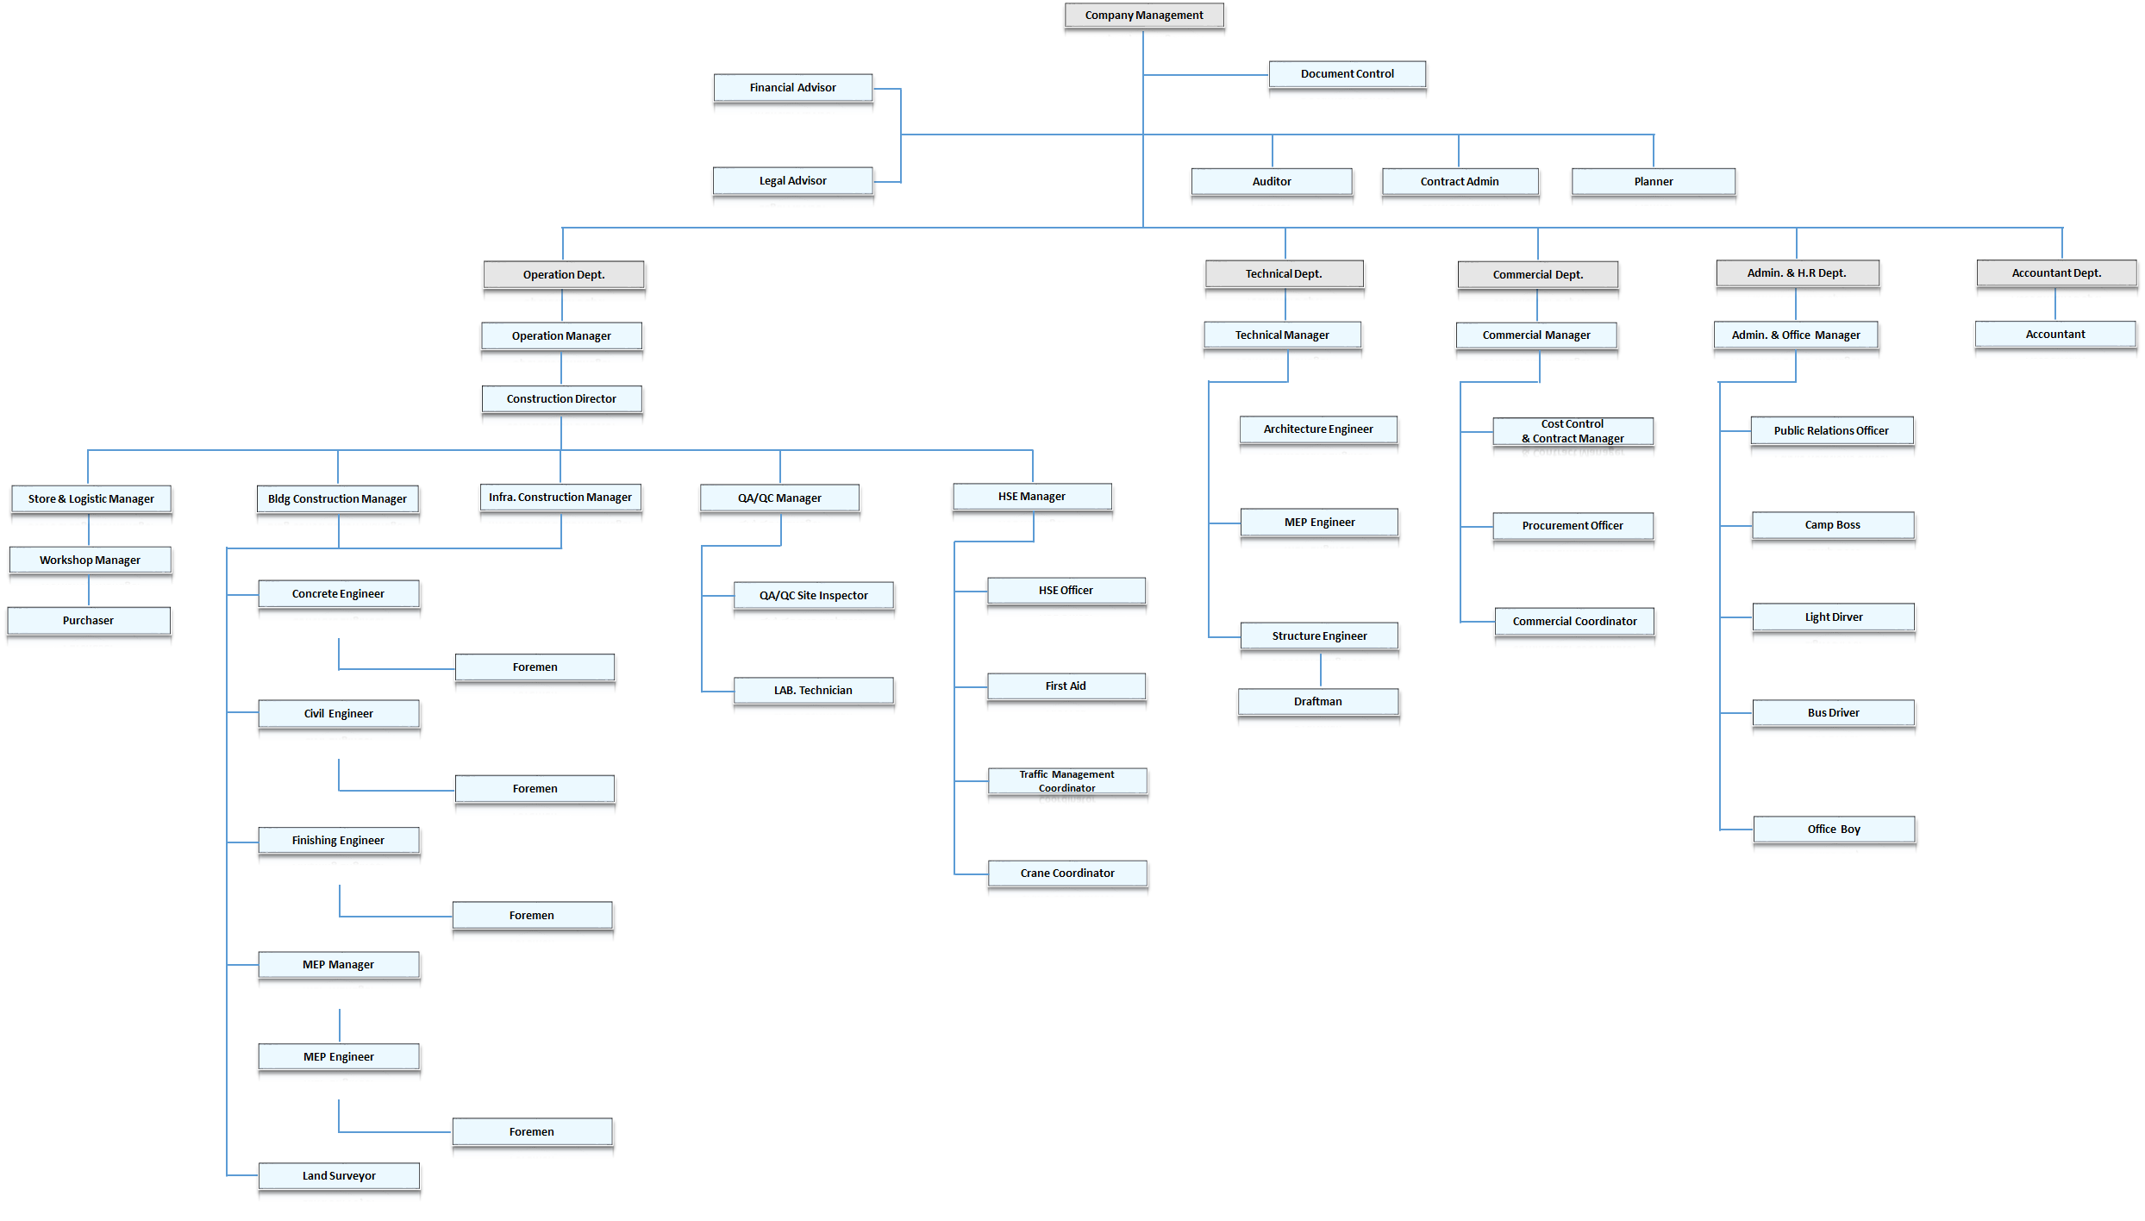
NANTONG ERJIAN CONTRACTING CO. L. L.C

Slide 10
NANTONG ERJIAN CONTRACTING CO. L. L.C
STAFF LIST

Slide 11
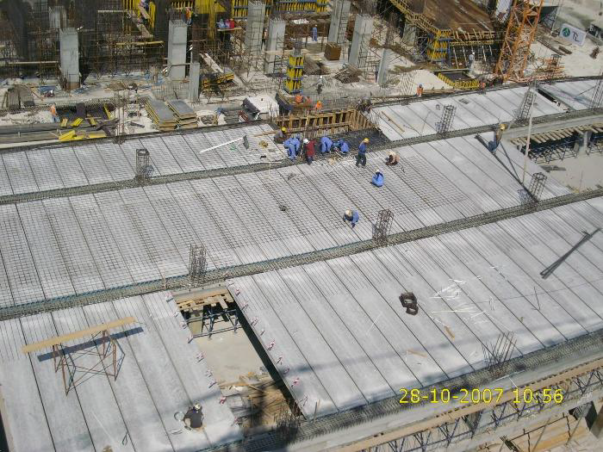
                NANTONG ERJIAN CONTRACTING CO. L.L.C
Description/ Position | No | Years of Experience
Chief Executive Officer | 1 | 48 years
Chief Financial Officer | 1 | 27 years
Chief Commercial Officer | 1 | 10 years
Operation Manager | 1 | 17 years
Construction Director | 1 | 20 years
Building Construction Manager | 1 | 15 years
Infra. Construction Manager | 1 | 14 years
HSE Manager | 1 | 12 years
QA/QC Manager | 1 | 12 years
Technical Manager | 1 | 18 years
Commercial Manager | 1 | 10 years
Admin Manager | 1 | 12 years
H.R Manager | 1 | 9 years
Project Director | 1 | 21 Years
Project Managers | 5 | >10 years
Skilled & unskilled laborers | > 1000 | As required

Slide 12
NANTONG ERJIAN CONTRACTING CO. L. L.C
MAJOR PROJECTS
Major projects executed or under execution by
NANTONG ERJIAN CONTRACTING CO. L.L.C & Partners

Slide 13
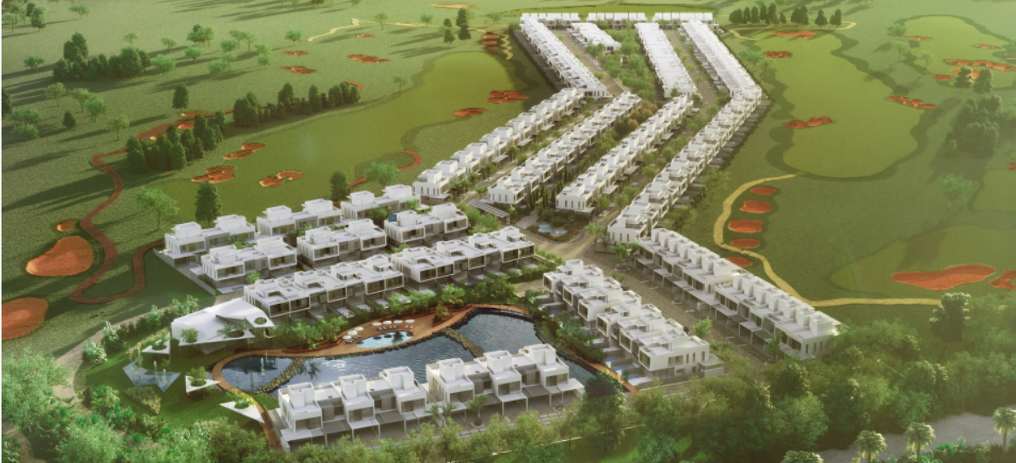
NANTONG ERJIAN CONTRACTING CO. L. L.C
Project under execution in UAE
No | Client | Project Name & Location | Project Description | Project Value USD | Start Date | Completion Date
1 | Jumeirah Golf Estate L.L.C Jumeirah Luxury Living L.L.C | Jumeirah Golf Villa Project, Dubai | Engineering, Construction, Completion, Maintenance | 100,729,609 | 23-Jul-18 | 22-Jul-20

Slide 14
NANTONG ERJIAN CONTRACTING CO. L. L.C
Some of Projects already executed in UAE
No | Client | Project Name & Location | Project Description | Project Value USD | Duration
1 | Samho L.L.C | Jebel Ali Container Terminal Project Stage I & II Load Test Pile Trimming Works in Dubai | Pilling Works | 4,214,000 | 2012-2014
2 | ADNEC L.L.C | Three Star Hotel, AbuDhabi | Pilling Works | 3,500,000 | 2013-2015
3 | AL Reef Real Estate | Baynonah Business Tower Jumeriah Village Dubai. | Building &Shoring & Pilling | 60,000,000 | 2012-2014
4 | New World investment Group | JResidential building (Al Jouri -6) Jumeirah Village Dubai | Building &Shoring & Pilling | 95,833,933 | 2011-2012
5 | Al Sondos Real Estate | Plot# 26&27, Proposed Residential Buildings at Dubai Land Dubai | Building & Pilling | 84,831,000 | 2011-2012
6 | Banyan | Financial house building plot 181, Abu Dhabi | Shoring & Excavation | 2,654,000 | 2010-2012

Slide 15
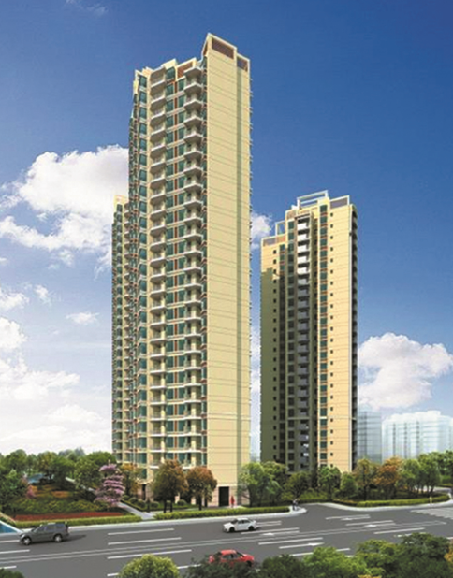
NANTONG ERJIAN CONTRACTING CO. L. L.C
Some projects executed- under execution in China
No | Client | Project Name | Description | Project Value USD
1 | Shudu estates Co. | Chengdu Shudu international hotel project | Engineering, Construction, Completion, Maintenance | 405,896,326,
2 | Haier Group | Qingdao haier factory project | Engineering, Construction, Completion, Maintenance | 188,562,000
3 | Qiudan estates Co. | Shenyang dalong residential Project | Engineering, Construction, Completion, Maintenance | 105,648,500
4 | Hengda group | Nanjing muyun residential project | Engineering, Construction, Completion, Maintenance | 102,500,000

Slide 16
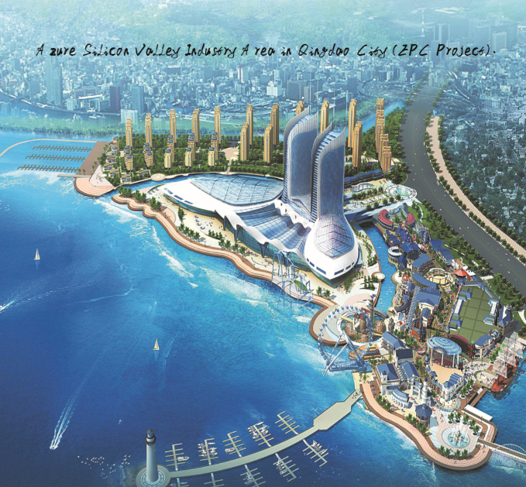
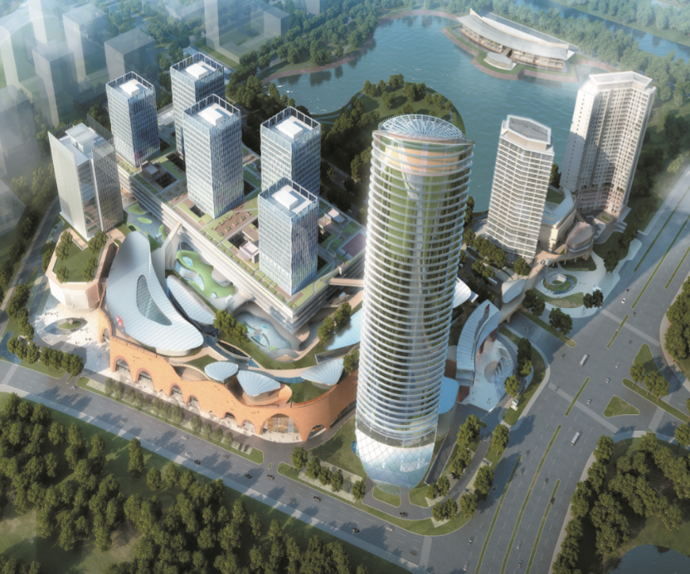
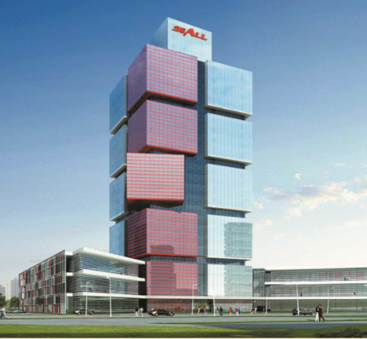
NANTONG ERJIAN CONTRACTING CO. L. L.C
Some projects already executed in China
No | Client | Project Name | Description | Duration | Project Value USD
1 | Qingdao municipality authority | Azure silicon valley industry area in Qingdao city | EPC | 2012-2015 | 606,000,000
2 | Nanjing zijin community authority | Nanjing zijin science and technology venture special community BT project | EPC | 2011-2015 | 832,154,000
3 | Chengdu development investment group | Chengdu development building in jian of Jiangxi province | EPC | 2013-2016 | 102,200,000
4 | Suzhou industry park investment group | The storage transportation administration service center in Suzhou industry park | EPC | 2014- 2017 | 106,300,000
5 | Haishanghai estates group | Haishanghai office buildings in shanghai province | EPC | 2015- 2017 | 96,100,000

Slide 17
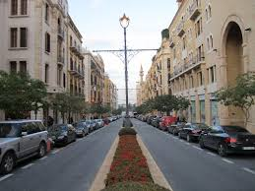
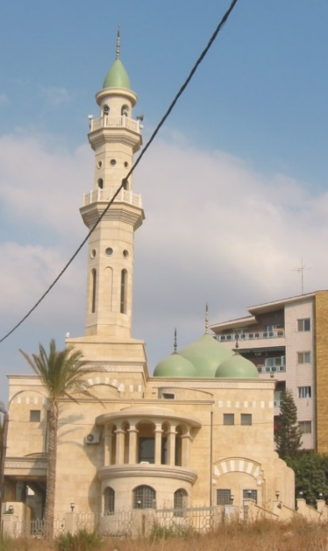
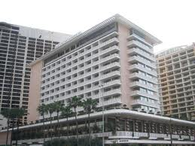
NANTONG ERJIAN CONTRACTING CO. L. L.C
Some projects already executed in Lebanon
No | Client | Project Name | Description | Duration of Contract | Project Value USD
1 | Private | Rmeil Residence | 17 Story New Building Lebanon | 2008-2010 | 6,500,000
2 | Private | Prince Talal Bin Abdel Aziz Villa | Villa and ancillaries Yarze, Lebanon | 1996-2000 | 14,500,000
3. | Private | Qousaybi Villa | Villa and ancillaries Yarze, Lebanon | 1999-2000 | 8,500,000
4 | Private | Lebanese Preparatory School | Buildings and ancillaries Lebanon | 1994-1998 | 1,600,000
5 | Private | King Abdulla Bin Abul Aziz Faculty Al Manar University | Buildings and ancillaries Lebanon | 2010-2012 | 10,000,000
6 | Private | Caesar Palace Hotel | Concrete repair, basement addition, and refurbishment Lebanon | 2006-2009 | 7,700,000

Slide 18
NANTONG ERJIAN CONTRACTING CO. L. L.C
EQUIPMENT LIST

Slide 19
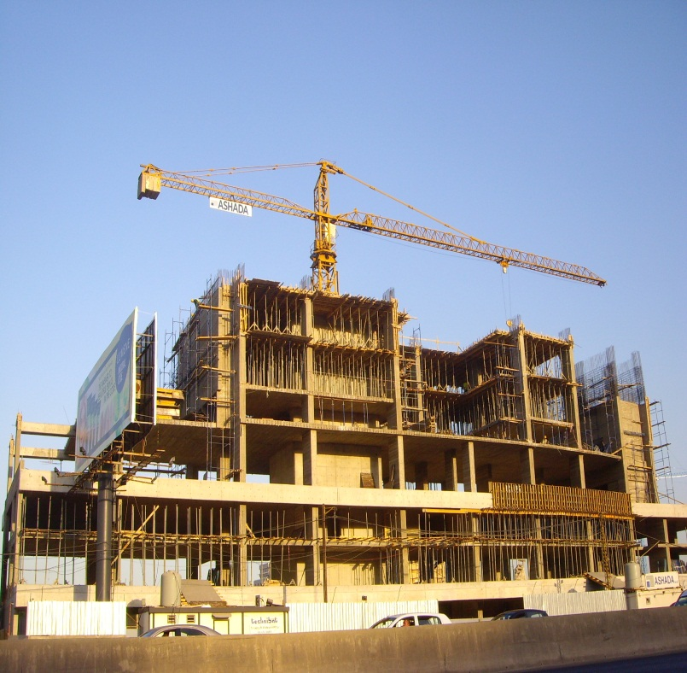
NANTONG ERJIAN CONTRACTING CO. L. L.C
Machineries and Equipment
Item number | Description | Quantity
Cranes
1 | T/CRANE - POTAIN-428 36M JIB HUH 36M - A | 8
2 | T/CRANE - POTAIN-764E 48M JIB HUH | 6
3 | CRANE POTAIN MC 85 B | 4
4 | Tower Crane Electric Powered- Concrete Foundation Non Slewing 5,10 ton | 12
5 | Mobile crane 200 ton | 1
Heavy Machines
6 | Shovel KOMATSU 470 | 1
7 | Shovel CAT 962 G | 2
8 | Volvo Excavator 290BLC | 11
9 | Volvo Excavator 360BLC | 3
10 | Volvo Excavator 240BLC | 2
11 | Volvo Excavator 210BLC | 1
12 | Komatsu Excavator PC 300-7 | 2
13 | Excavators SH 330-3 | 7
14 | Extic Crusher | 2
15 | M.B Bucket Crusher | 8
16 | LoaderBobcat 753 B | 6
17 | Loader:Ford-New Holland LX 565 | 4
18 | Backhoe;Massey Fergusson | 1
19 | Comp actor :Hamm HO 10 | 1
20 | CompressorAtlas Copco XA S 653,7m3/min | 1
21 | Compressor:Atlas Copco XA90-184cfm | 1
22 | JCB JS205 | 4
23 | JCB 3CX | 2
24 | JCB 540-170 | 1
25 | JCB Digger 2006 | 1
26 | JCB type Sidon | 1
27 | JCB | 1
28 | JCB tele Handler model 2008 | 1
29 | Bobcat S130 Skid Loader | 2
30 | Bobcat Skid Steers | 4
31 | Pearl Air Compressor | 1
32 | Portable Diesl Compressor | 1
33 | Air Compressor | 1
34 | Compressor /SSS12 | 1
35 | Crawler Excavator XE345C | 1
36 | JCB JS330LC Tracked Excavators | 4
37 | Wheel Loader LW 600 k | 1

Slide 20
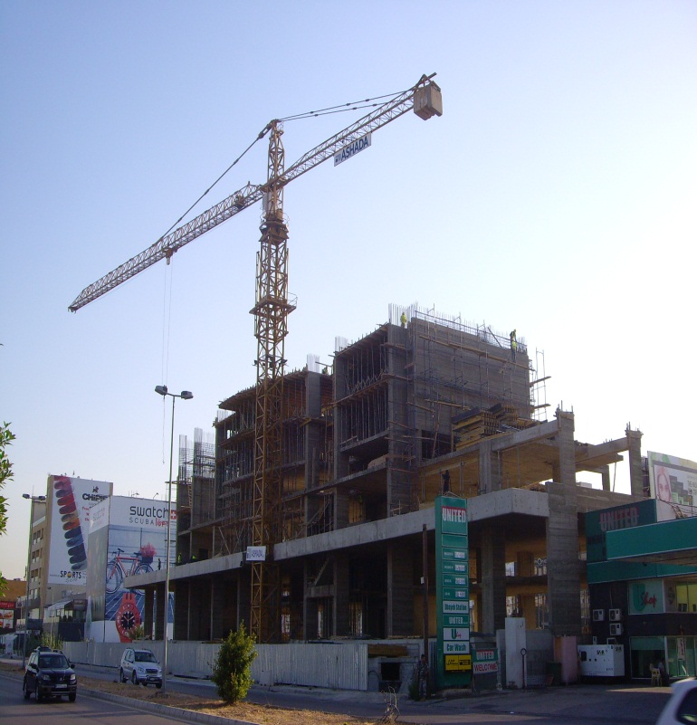
NANTONG ERJIAN CONTRACTING CO. L. L.C
Heavy Machines
38 | JacK Hammer for JCB | 1
39 | Dumper 1.5 Ton Diesl Engine | 1
40 | Plact Compactor | 3
41 | LF 80 Plate compactor | 3
42 | Jack Hammer | 2
43 | LT 800 Rammer | 4
44 | Oriental " Vibratory Plate Compactor" | 1
Forklifts
45 | Forklift Truck:Fiat OM Carelli DI 40C-3300MM | 3
46 | FORKLIFT TCMF | 1
47 | Forklift " Teke Handler Caterpillar" | 1
Generators
48 | GENSET-PERKINS JGP 135 K.V.A | 10
49 | GENSET-PERKINS JGP 45 K.V.A | 8
50 | Genset 20.3-18 KVA | 1
51 | SAC Genset | 2
52 | Generators | 34
Rollers
53 | Ingersoll Roller | 1
54 | Double Vibratory Rollers:Vibromax Roller W62 | 1
55 | Diesel Engine Vibrator Roller 1.5 Ton | 2
56 | Roller | 1
57 | Duplex Roller with Manual Start | 1
Furniture and Topographic Items
58 | Office and Site Furniture | 25
59 | Prefabricated Unit Offices | 32
60 | Topografic Equipment | 6
61 | Ts06 plus Total Station | 1
62 | Level 360 degree with accessories | 7
63 | Level Station plus accessories | 7
64 | Radios | 10
65 | Container | 45
66 | Leica Survey | 6

Slide 21
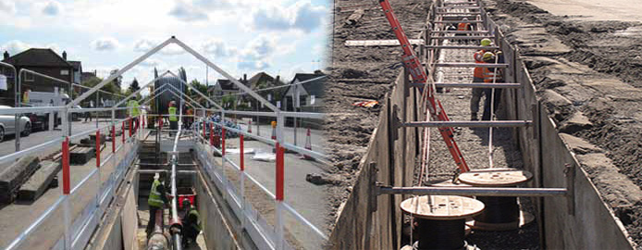
NANTONG ERJIAN CONTRACTING CO. L. L.C
Trucks and Mixers
68 | Mercedes Truck | 8
69 | Truck + Mobile Crane: Mercedes 1617 | 1
70 | Watertank : Truck : Mercedes 12.000 1 | 1
71 | Transit Mixer Cifa 12 m3 359179 | 3
72 | Dumper Mixer: Mosquito 13 : 2m3 | 1
73 | Concrete Mixer | 2
Miscellaneous Items
74 | Sand Blasting Machine | 2
75 | Bar Proliner Pressure Water | 2
76 | Alivon Breaker | 2
77 | Marble Cleaning Machine | 1
78 | Brush Cutters | 2
79 | Environmental meter for AC | 1
80 | Vertical Risers | 1
81 | Grass Cutter | 1
82 | Concrete Vibrator | 46
83 | Water Pump 3" x 3" | 1
84 | Hole Saw Cutter | 1
85 | Gasoline Power Trowler | 2
86 | Pneumatic Breaker Tex 220 | 3
87 | Greenlee Meter Light Digital | 1
88 | Tower Lights | 1

Slide 22
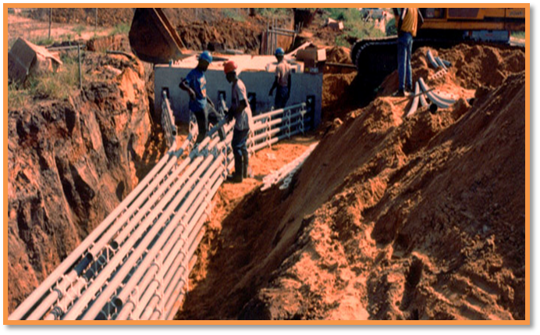
NANTONG ERJIAN CONTRACTING CO. L. L.C
Cars and Vehicles
Item number | Description | Quantity
1 | NISSAN PICK-UP | 64
2 | Subaru Outback | 1
3 | Mitsubishi Montero | 1
4 | Toyota RN 16 Pick UP- Petrole | 1
5 | Toyota BU 112 Pick Up-Diesel | 1
6 | Renault Rapid VAN commercial | 1
7 | Toyota YU63 Pick up commercial | 1
8 | Toyota Hiace pick up commercial- VAN | 1
9 | Subaru Legacy - | 1
10 | Mazda 323 | 1
11 | Kia Picanto | 1
12 | Honda Foresight | 1
15 | Pick Up Mitsubishi | 1
16 | Pick Up 2400 Mo 09 | 1
17 | Tata Bus 66 seater | 23
18 | Bus Nissan | 2
19 | JAC Truck | 2
20 | Jack HFC Water Tank | 1
21 | Unit Canter 6 Ton | 1
22 | Mitsubishi Canter plate | 2
23 | Nissan Pathfinder | 4
24 | X trail Nissan | 4
25 | Car X Terra | 3
26 | Xterra Nissan | 1
27 | Nissan Tida | 1
28 | Nissan Sentra | 1
29 | Car Nissan Sunny | 1
30 | Car Toyota | 1
31 | Toyota Corolla Sedan | 1
32 | Tida Car Model | 5
33 | Renault Car | 1
34 | Caravan | 1
35 | Van | 2

Slide 23
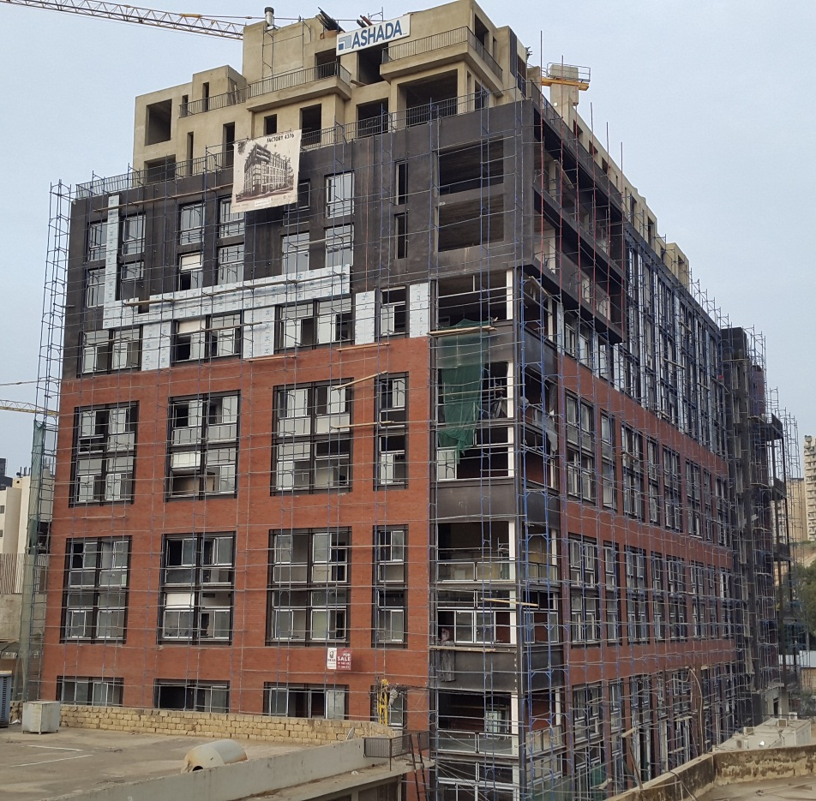
NANTONG ERJIAN CONTRACTING CO. L. L.C
Doka
Item number | Description | Quantity
1 | Formwork element connector FF20/50 2 | 210 pcs
2 | Adjustable waling extension FF20/50 | 90 pcs
3 | Beam clamp Top50 | 360 pcs
4 | Universal angle tie bracket | 560 pcs
5 | Connecting pin 10cm | 7400 pcs
6 | Internal angle plate H20 Top50 | 360 pcs
7 | Tie rod 15.0mm non-treated 1.00m | 320 pcs
8 | Tie rod 15.0mm non-treated 1.50m | 2200 pcs
9 | Tie rod 15.0mm non-treated 0.50m | 80 pcs
10 | Anchor plate 12/12 | 2760 pcs
11 | Wing nut 15.0 | 3240 pcs
12 | Waling clamp H20 | 13020 pcs
13 | Panel strut 540 | 210 pcs
14 | Top scaffold bracket L painted | 300 pcs
15 | Beam screw H 8/70 | 3600 pcs
16 | Multi-purpose waling WS1 0 TopSO 4.00m | 90 pcs
17 | Multi-purpose waling WS10 Top50 3.50m | 140 pcs
18 | Multi-purpose waling WS1 0 TopSO 3.00m | 280 pcs
19 | Multi-purpose waling WS10 Top50 2.75m | 120 pcs
20 | Multi-purpose waling WSlOTop50 2.50m | 180 pcs
21 | Multi-purpose waling WS10 Top50 2.25m | 220 pcs
22 | Multi-purpose waling WS1 0 Top50 2.00m | 120 pcs
23 | Multi-purpose waling WS10 TopSO 1.75m | 160 pcs
24 | Multi-purpose waling WS1 0 Top50 1 .50m | 240 pcs
25 | Multi-purpose waling WS10 TopSO 1.25m | 40 pcs
26 | Multi-purpose waling WS10 TopSO 0.75m | 20 pcs
27 | Multi-purpose waling WS10 TopSO 1.00m | 20 pcs
28 | Doka beam H20 eco N 1.25m | 360 pcs
29 | Doka beam H20 eco N 1.80m | 1630 pcs
30 | Doka beam H20 eco N 2.45m | 3350 pcs
31 | Doka beam H20 eco N 2.65m | 3250 pcs
32 | Doka beam H20 eco N 2.90m | 7110 pcs
33 | Doka beam H20 eco N 3.30m | 5400 pcs
34 | Doka beam H20 eco N 3.60m | 410 pcs
35 | Doka beam H20 eco N 3.90m | 190 pcs

Slide 24
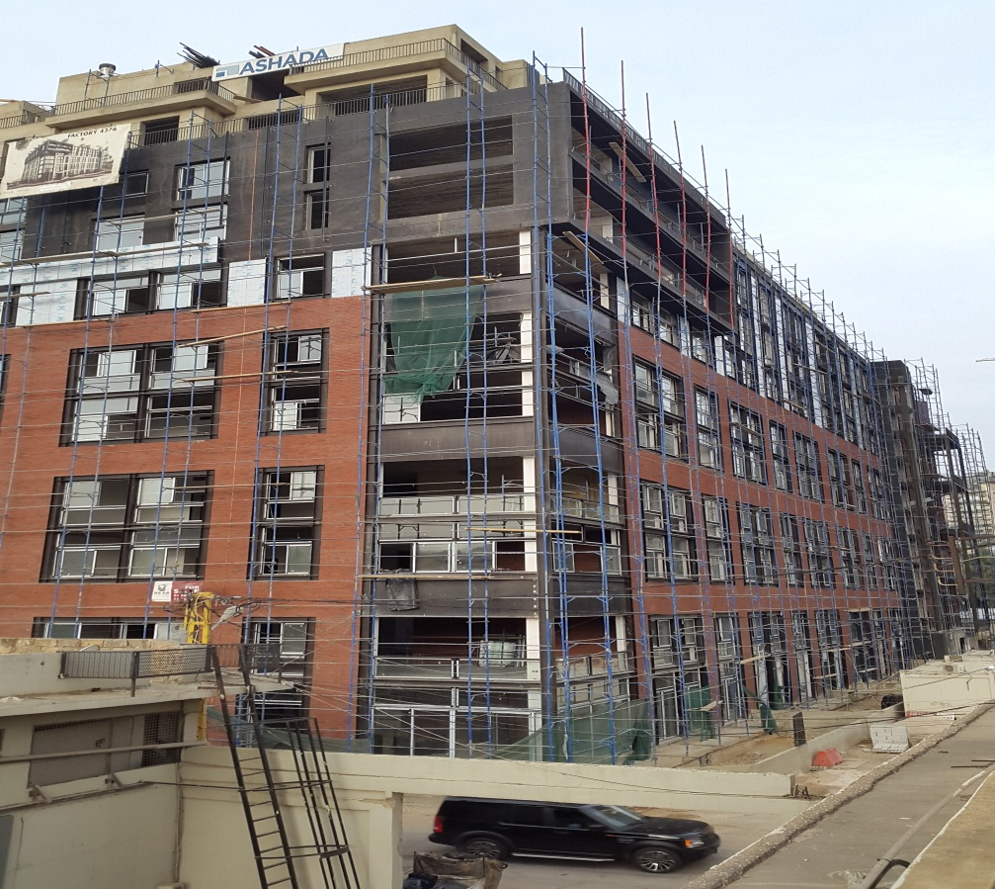
NANTONG ERJIAN CONTRACTING CO. L. L.C
Doka
36 | Doka beam H20 eco N 4.50m | 100 pcs
37 | Doka beam H20 eco N 4.90m | 340 pcs
38 | Doka beam H20 eco N 5.90m | 990 pcs
39 | Lifting bracket | 600 pcs
40 | Doka floor prop Eurex 20 400 | 9840 pcs
41 | Removable folding tripod | 2300 pcs
42 | 4-way head H20 | 2300 pcs
43 | Supporting head H20 DF | 7540 pcs
44 | Assembly angle TopSO | 30 pcs
45 | Tool box GF | 10 pcs
46 | Strip tensioner B 5.00m | 20 pcs
47 | Tie rod wrench 15.0/20.0 | 20 pcs
48 | Top scaffold bracket L painted | 400 pcs
49 | Waling clamp H20 | 9380 pcs
50 | Beam screw S 8/60 | 3400 pcs
51 | Cone screw B 7cm | 240 pcs
52 | Positioning clamp M30 | 150 pcs
53 | Sealing sleeve K 15.0 | 1500 pcs
54 | Stop anchor 15.0 16cm | 1500 pcs
55 | Universal climbing cone 15.0 | 240 pcs
56 | Formwork element connector FF20/50 Z | 290 pcs
57 | Adjustable waling extension FF20/50 | 110 pcs
58 | Beam clamp TopSO | 600 pcs
59 | Internal angle plate H20 TopSO | 120 pcs
60 | Assembly angle TopSO | 10 pcs
61 | Anchoring plate FF20/50 | 80 pcs
62 | Doka Prop EUREX 20 350 | 1500 pcs
63 | Doka floor Prop EUREX 20 350 | 500 pcs
64 | Scaffolding | 4500 m2

Slide 25
NANTONG ERJIAN CONTRACTING CO. L. L.C
QUALITY MANAGEMENT SYSTEM

Slide 26
NANTONG ERJIAN CONTRACTING CO. L. L.C
NANTONG ERJIAN CONTRACTING CO. L.L.C . has consistently developed a reputation for quality work and on time provider of high class construction, on which it continued to build in order to maintain the admiration and satisfaction of all Clients.
As we grow, NANTONG ERJIAN CONTRACTING CO. L.L.C . shall remain committed to developing its Quality Management System and maintaining trustworthy partnerships with its Clients.
“The Company of choice for quality construction”
Signed……………………….. Date…………
President

Slide 27
NANTONG ERJIAN CONTRACTING CO. L. L.C
Quality policy
The Executive Management of NANTONG ERJIAN CONTRACTING CO. L.L.C. is committed to achieving, maintaining and improving its services to provide the highest level of Client satisfaction.
To achieve this overall objective it is the Company’s intention to thoroughly understand the needs and requirements of each Client, to agree the substance of such needs and to define them so that our resources and efforts can be properly and effectively directed and performance objectively measured, analyzed and continually improved.
For this purpose, NANTONG ERJIAN CONTRACTING CO. L.L.C operates a Quality Management System structured to meet the and designed to meet the needs of clients’ management and stakeholders.
The V System arrangements are defined in a hierarchy of manuals, processes, procedures and associated supporting documents. These documents are subject to planned systematic audits and management reviews to demonstrate their effectiveness, compliance with NANTONG ERJIAN CONTRACTING CO. L.L.C success factors and Management’s commitment to, among other things:
Meet completion schedules.
Consistently providing high quality service, to Client requirements.
Implementation of NANTONG ERJIAN CONTRACTING CO. L.L.C strategic requirements of service and/or product excellence by NANTONG ERJIAN CONTRACTING CO. L.L.C sub-contractors/suppliers.
Employees’ competence, awareness and training.
Operational performance monitoring and continual improvement.
Monitor and rationalize the cost bases of its work.
Maintain marketing strategies for future project opportunities.

Slide 28
NANTONG ERJIAN CONTRACTING CO. L. L.C
Environmental Policy
This policy for the UAE region calls for continued improvement in the activities of Environmental protection in the organization and for the prevention of pollution on the following principles:
Recognition that a commitment to the Environmental aspects of its organization is good business sense and that a high level of Environmental awareness has positive benefits to the organization.
Maintaining an Environmental program which meets the legal requirements of the region and all other authorities having jurisdiction over the work.
Setting effective key objectives on a yearly basis that will be reported against.
These reports will form the basis of review for the program to ensure the continued improvement of standards.
To embody a futuristic vision in all commercial decisions that may have an impact on our Environmental Aspects.
To ensure that the program is communicated to all persons working under the control of the company with the intent that they are all aware of their individual Environmental obligations.
Training of the employees with regard to the requirements and responsibilities of Environment protection, the prevention of pollution and the reduction of natural resource consumption.
Signature: |  | Date:

Slide 29
NANTONG ERJIAN CONTRACTING CO. L. L.C
Health & Safety policy
NANTONG ERJIAN CONTRACTING CO. L.L.C ensures that health and safety regulations are part of its responsibility and that the company deems this vision as its basic responsibility and core factor in considering the health & safety standards.
The Health & safety policy of company calls for continual enhancement in the activities of Health and Safety in the organization as per the following principles:
Following all the health & safety laws & byelaws.
A commitment to prevent any injury to employees and visitors of company during the work.
Following the principles of continual improvement and ensuring the best utilization of the resources of departments in all matters of Health & Safety.
Following up on performance to achieve all goals of the Health & Safety policy in different activities and program of company.
Taking proper care to ensure that the company’s activities are safe for the partners, employees, subcontractors and all others who deal with company including general public.
Coordination with customers and the suppliers to ensure the implementation of the principles of Health highest standards of Safety.
To embody a futuristic vision in all commercial decisions that may have an impact on Health & Safety.
Training the employees with regards to the requirements and responsibilities of the Health & Safety.
Supporting and educating individuals who are not accustomed in following the principles of Health & Safety.
Signature: | Date: …………………..

Slide 30
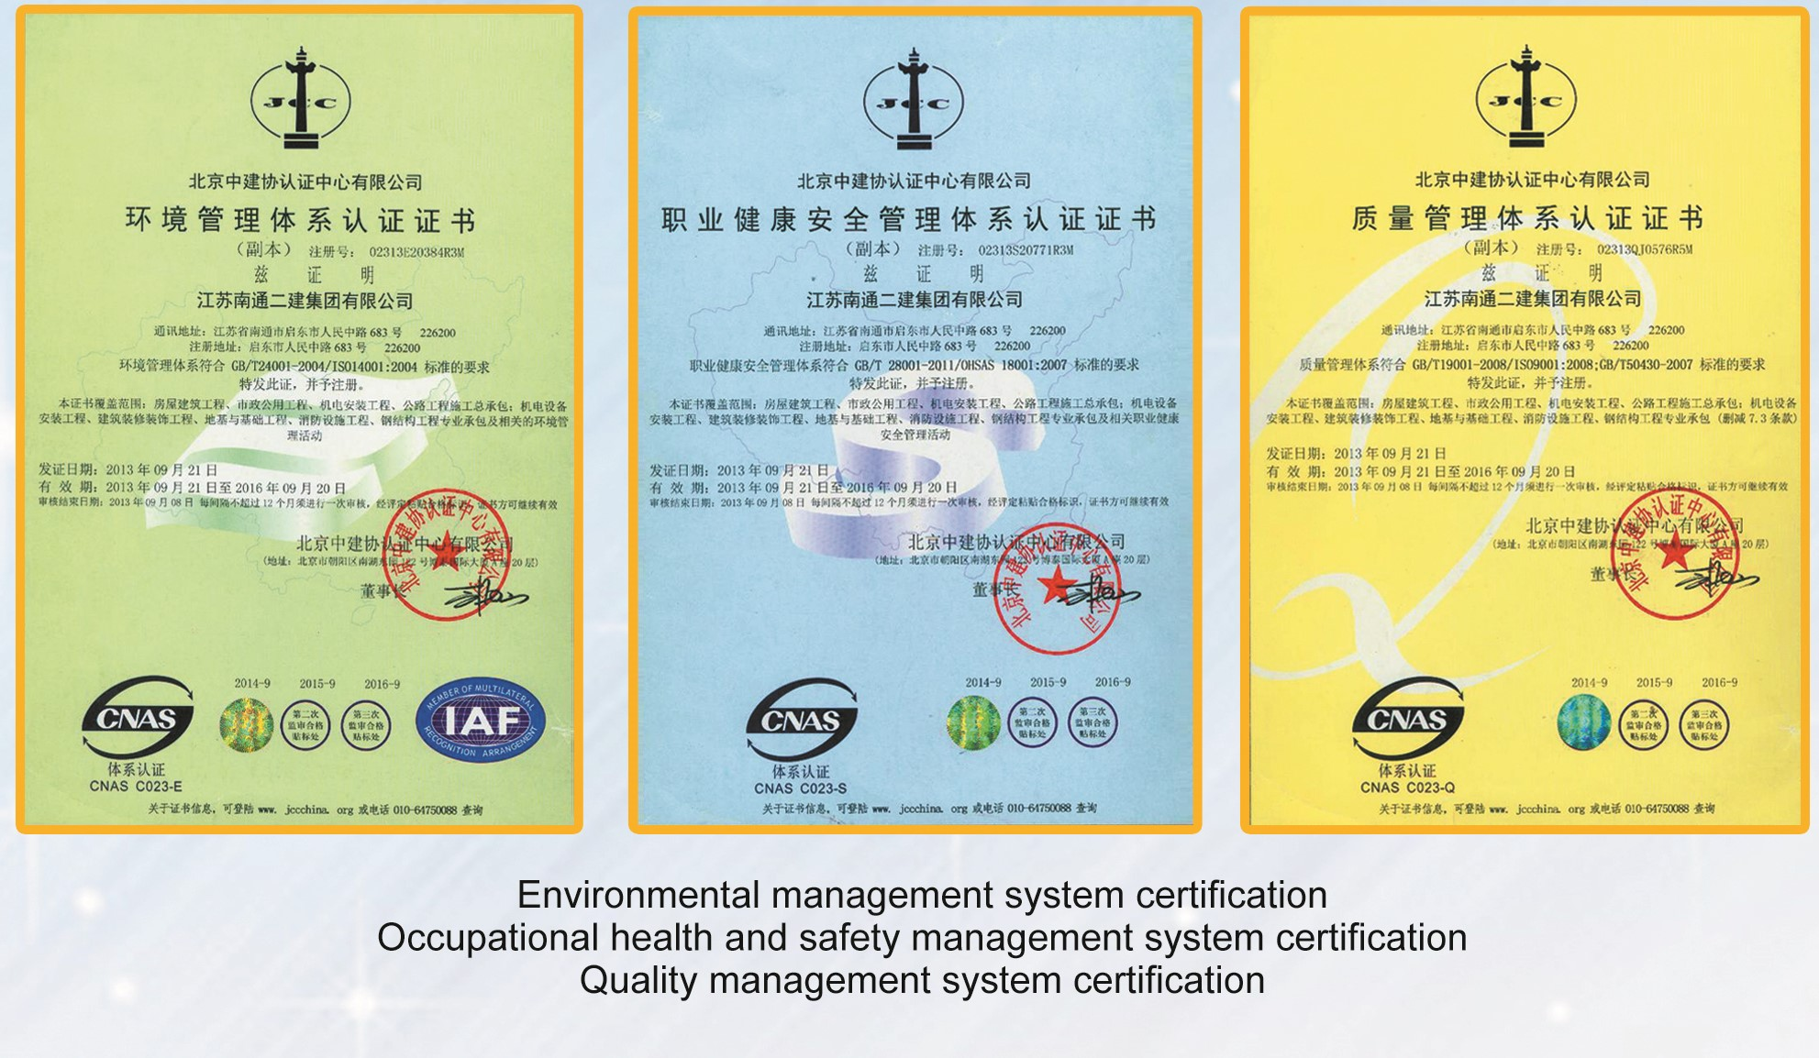
                Partners ISO Certification
NANTONG ERJIAN CONTRACTING CO. L. L.C

Slide 31
NANTONG ERJIAN CONTRACTING CO. L. L.C
FINANCIAL STATUS & STATEMENTS

Slide 32
NANTONG ERJIAN CONTRACTING CO. L. L.C
Nantong Erjian contracting Co. L.L.C financials for the last three years are available upon request.
List of Banks:
Lebanese Swiss Bank ( Lebanon)
Bank of CHINA ( CHINA)
Abu Dhabi Commercial Bank ( UAE )

Slide 33
NANTONG ERJIAN CONTRACTING CO. L. L.C
TRADE LICENSES & CLASSIFICATIONS

Slide 34
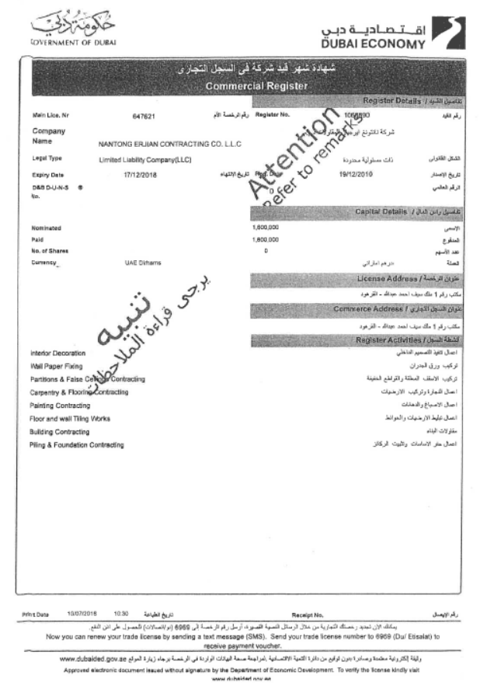
                REGISTRATION
NANTONG ERJIAN CONTRACTING CO. L. L.C

Slide 35
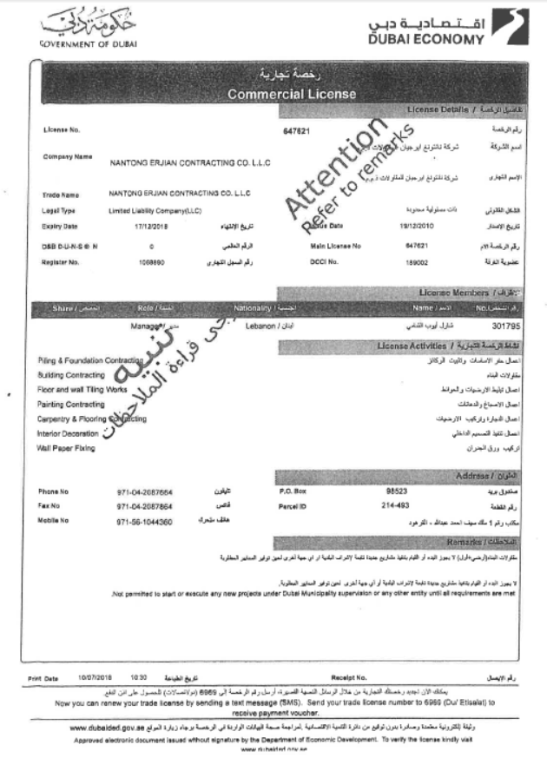
                LICENSE
NANTONG ERJIAN CONTRACTING CO. L. L.C

Slide 36
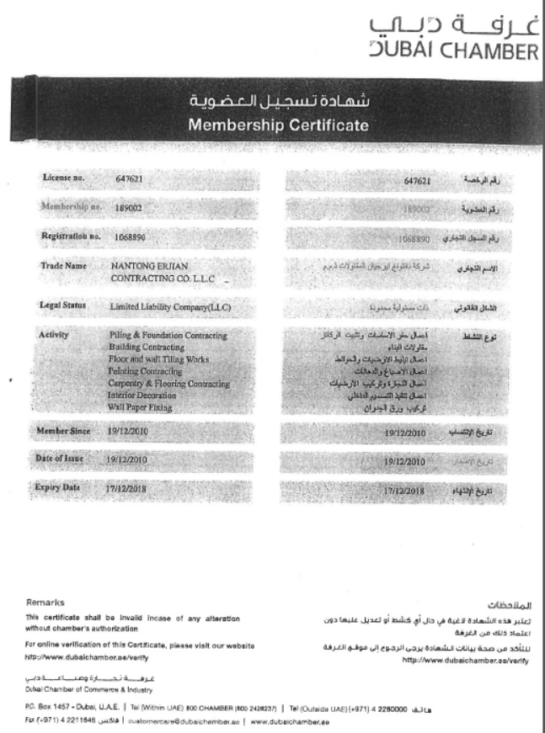
                CERTIFICATE
NANTONG ERJIAN CONTRACTING CO. L. L.C

Slide 37
NANTONG ERJIAN CONTRACTING CO. L. L.C
PHOTO GALLERY of SELECTED PROJECTS

Slide 38
                UAE
NANTONG ERJIAN CONTRACTING CO. L. L.C
JOURI 5 ,6 AND ORCHID TOWER
JUMEIRAH VILLAGE
DELTA BUSINESS CENTRE

Slide 39
                UAE
NANTONG ERJIAN CONTRACTING CO. L. L.C
BAYNOUNAH TOWER
JUMEIRAH VILLAGE
ARCHERY TOWER
SPORTS CITY

Slide 40
                UAE
NANTONG ERJIAN CONTRACTING CO. L. L.C
PLATINUM TOWER
RESIDENTIAL 07 BUILDINGS
DUBAI LAND
TWIN TOWER UP TO 30 FLOORS

Slide 41
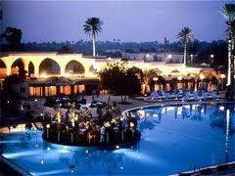
                LEBANON
NANTONG ERJIAN CONTRACTING CO. L. L.C
Rmeil Residence Project
17 Story New Building
Sea View
Residence Project

Slide 42
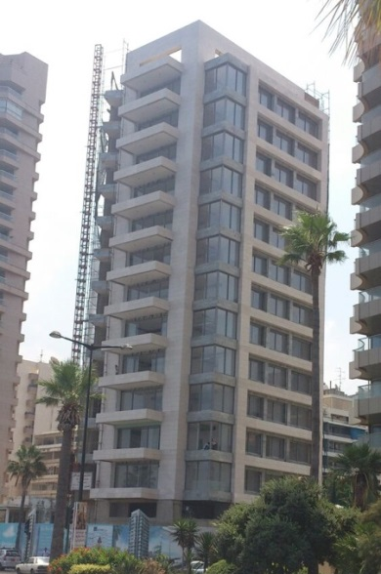
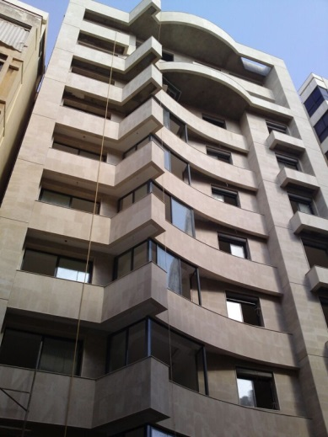
                LEBANON
NANTONG ERJIAN CONTRACTING CO. L. L.C

Slide 43
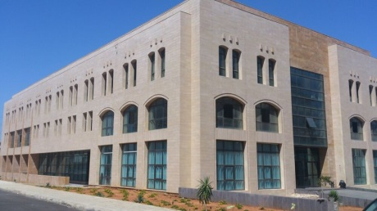
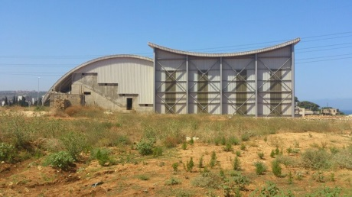
                LEBANON
NANTONG ERJIAN CONTRACTING CO. L. L.C
King Abdulla Bin
Abul Aziz Faculty
Al Manar University
Prince Al Walid Bin Talal
Olympic Stadium
Al Manar University

Slide 44
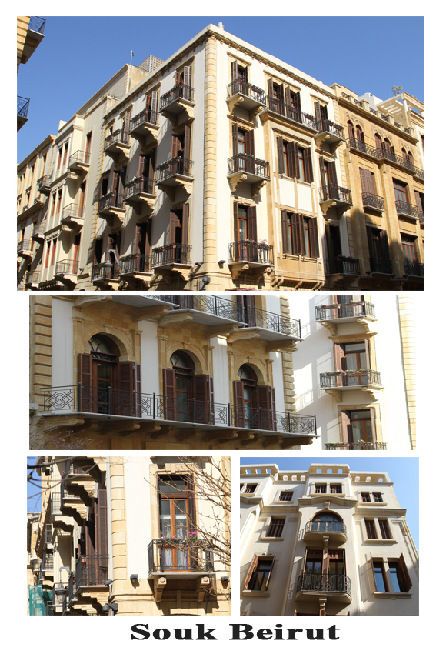
                LEBANON
NANTONG ERJIAN CONTRACTING CO. L. L.C

Slide 45
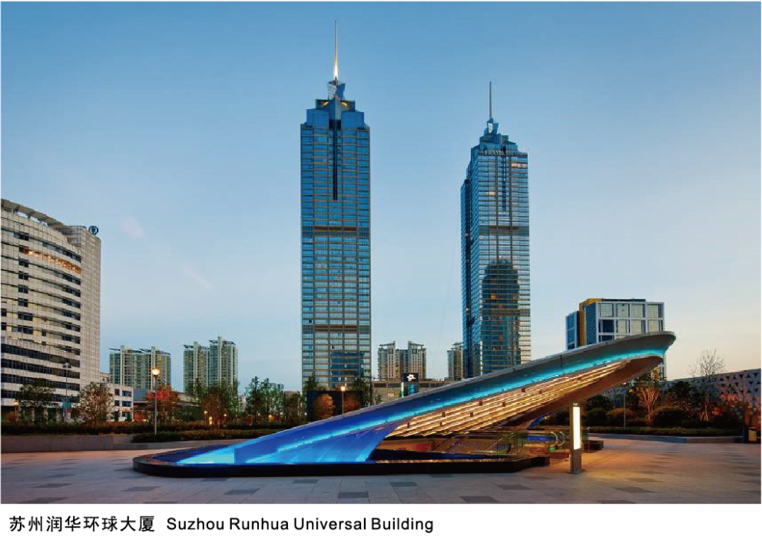
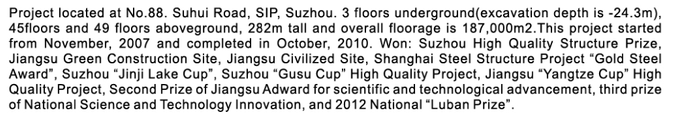
                CHINA
NANTONG ERJIAN CONTRACTING CO. L. L.C

Slide 46
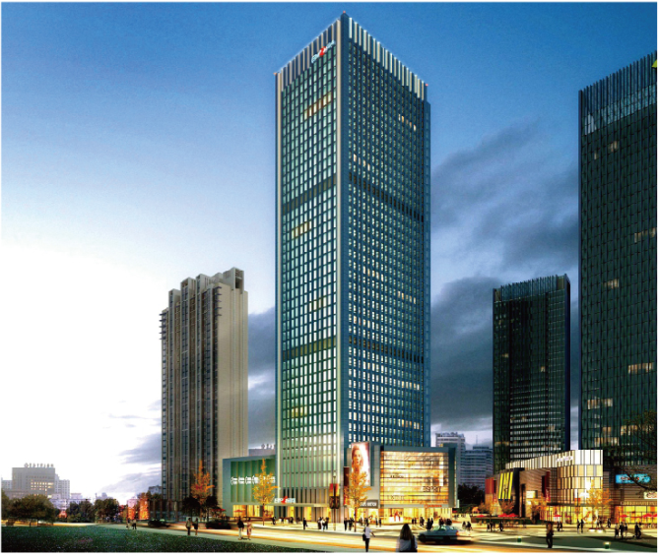
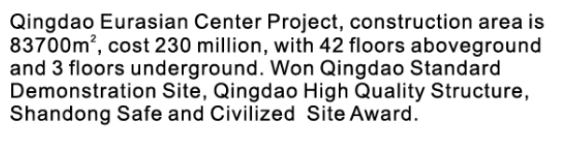
                CHINA
NANTONG ERJIAN CONTRACTING CO. L. L.C

Slide 47
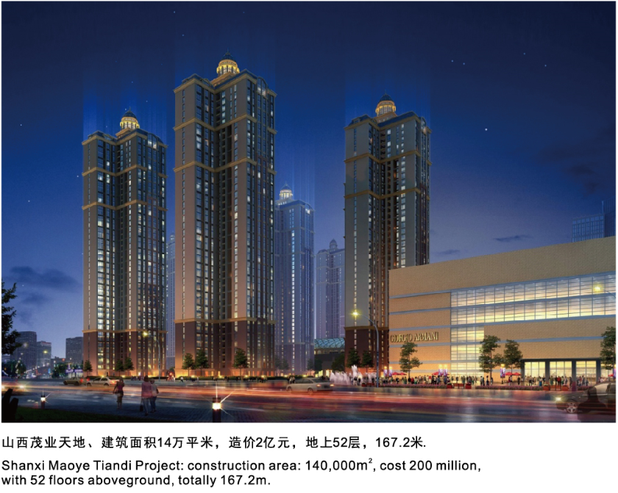
                CHINA
NANTONG ERJIAN CONTRACTING CO. L. L.C

Slide 48
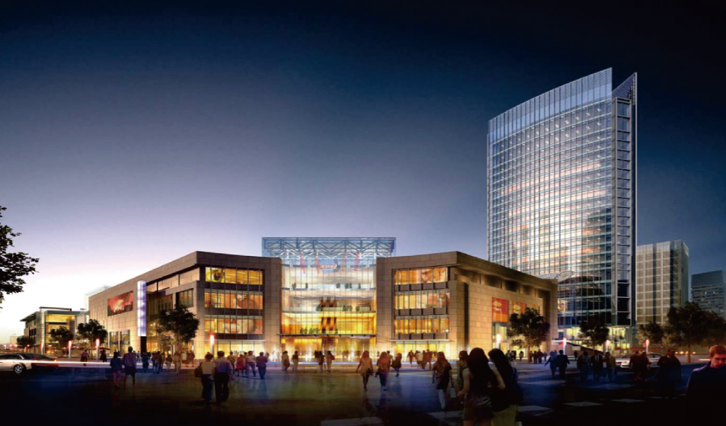
                CHINA
NANTONG ERJIAN CONTRACTING CO. L. L.C

Slide 49
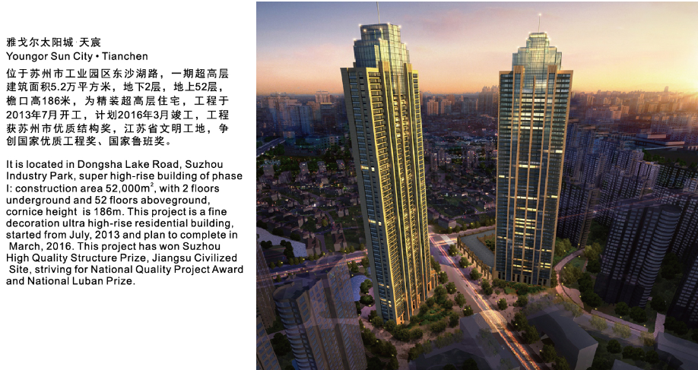
                CHINA
NANTONG ERJIAN CONTRACTING CO. L. L.C

Slide 50
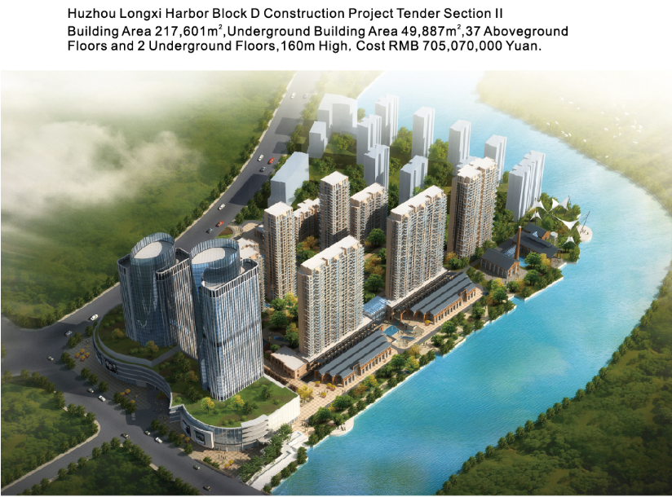
                CHINA
NANTONG ERJIAN CONTRACTING CO. L. L.C

Slide 51
NANTONG ERJIAN CONTRACTING CO. L.L.C

